Slide 1


Major Project-I (CA301P) ODD Semester Session 2025-26
TimeCoins (The Currency of Moments)
Aman Kumar 202410116100020
Anand Patel 202410116100023
Deepu kumari 202410116100057
Project Supervisor:
Ms. Hunny Gaur

Slide 2

Introduction
TimeCoins is an innovative platform combining instant messaging, digital currency, and real-time notifications in one seamless system. We aim to revolutionize communication by enabling users to chat, share media, and make secure financial transactions in the same app. Our unique in-app currency, TimeCoins, is designed to grow in value and bring financial engagement into everyday conversations.
Instant Messaging
Real-time Notifications
Digital Currency
Seamless Integration

Slide 3
Key Features
User Authentication
Messaging System
Register, Login, Logout, Forgot Password.
Send text, pictures, and videos.
Notifications
TimeCoin Payments
Get instant alerts for messages, payments, and coin value changes.
Transfer coins directly within chat.
Value Fluctuation
Secure REST API
Similar to Bitcoin but mapped to company shares.
Built for speed and safety.

Slide 4






Technology Stack
Frontend
React.js (modern, responsive UI)
Backend
Spring Boot (Java)
Database
MySQL
Security
JWT Authentication, HTTPS encryption
Other Tools
REST API, WebSockets for real-time messaging & notifications
Designed for scalability, security, and cross-platform compatibility.

Slide 5

Architecture
User interacts with the Frontend (web interface).
Frontend communicates with REST API (Spring Boot).
API handles:
Authentication
Messaging
Payments
Notifications
Database stores user data, messages, and transaction logs.
Coin Value Service updates TimeCoin prices based on share values.
Notification Service pushes real-time alerts to users.

Slide 6


How TimeCoins Value Fluctuates
Mapped to Organisation Shares
TimeCoins’ value is tied to our organisation's share price.
If shares go up → TimeCoins value goes up.
If shares go down → TimeCoins value decreases.
Limited Supply
Because coins are backed by shares, they are scarce.
Demand Impact
Higher demand further increases value.
Shop Payments
Paying with TimeCoins means indirectly paying with shares.
Two Growth Drivers
Share market changes + demand.

Slide 7
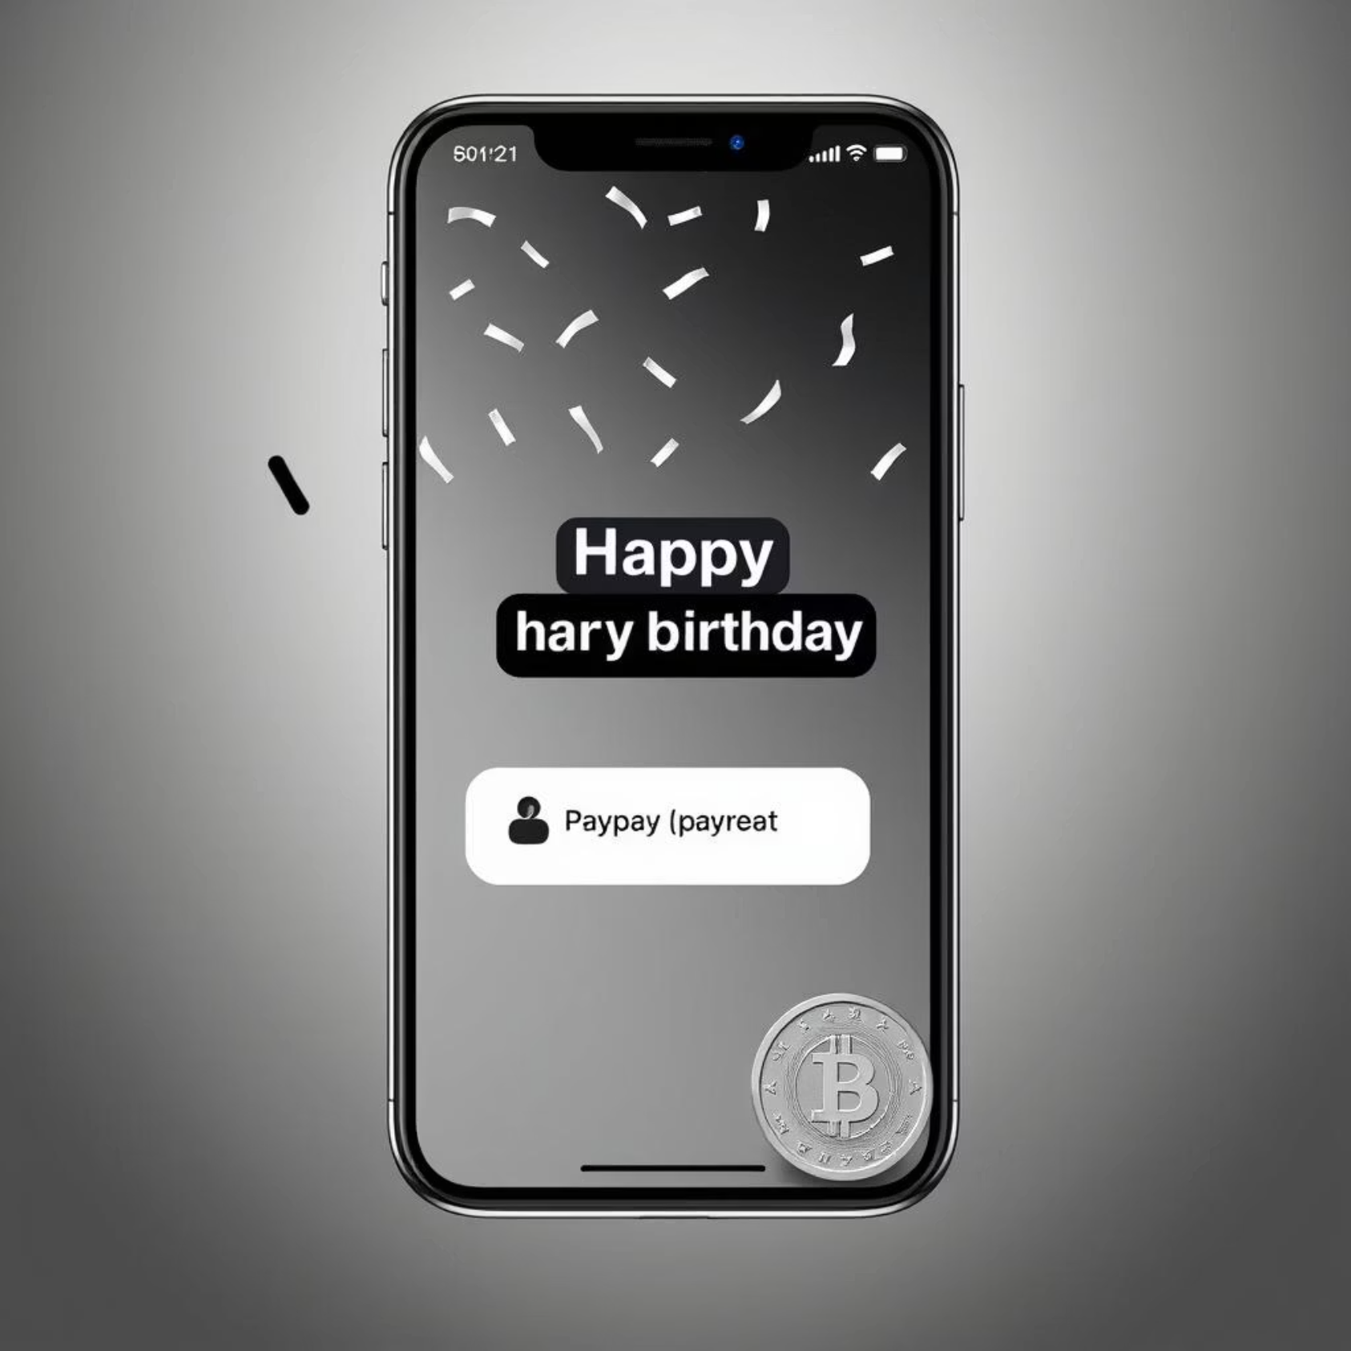
Messaging + Payments Integration
Send coins directly while chatting.
1
Instant deduction from sender’s balance.
2
Real-time update in recipient’s wallet.
3
Seamless user interface for smooth experience.
4
Example: Send “Happy Birthday 🎉” with 5 TimeCoins in one click.

Slide 8


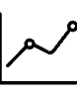
Notifications System
New Message Alerts
Payment Notifications
Value Change Alerts
Never miss a chat.
See instantly when you receive coins.
Get notified when TimeCoin value changes significantly.
Powered by real-time push technology for instant delivery.

Slide 9
Security Measures
JWT Authentication
Password Encryption
Secure session management.
Protect user credentials.
Secure API Endpoints
Transaction Safety
Prevent unauthorized access.
Double-spend prevention.

Slide 10
Timeline
Week 1-2 (15/08/25 – 30/08/25)
1
Requirement analysis & System Design.
2
Week 3-4 (31/08/25 – 11/09/25)
Backend Development (Authentication & Wallet Module).
Week 6-7 (12/09/25 – 26/09/25
3
Value Fluctuation Logic & Transactions Handling.
4
Week 8-10 (27/09/25 – 10/10/25)
Messaging System & payments Integration.
Week 11 (11/10/25 – 18/10/25)
5
Testing, Bug Fixing & Deployment.

Slide 11
SDG 8: Decent Work and Economic Growth
Boosting Digital Economy
TimeCoins creates a modern financial ecosystem where value is tied to organizational shares.
Encourages responsible and sustainable economic growth.
Inclusive Financial Access
Makes investment opportunities available to wider communities, including the unbanked.
Democratizes wealth creation through transparent share-backed coins.
Promoting Innovation & Jobs
Builds a new sector of employment around blockchain-inspired finance.
Supports startups and innovators by providing a reliable digital payment system.

Slide 12




Future Enhancements
Mobile app with push notifications.
AI-driven coin value predictions.
Group payments and shared expenses.
Multi-language support for global reach.

